Slide 1
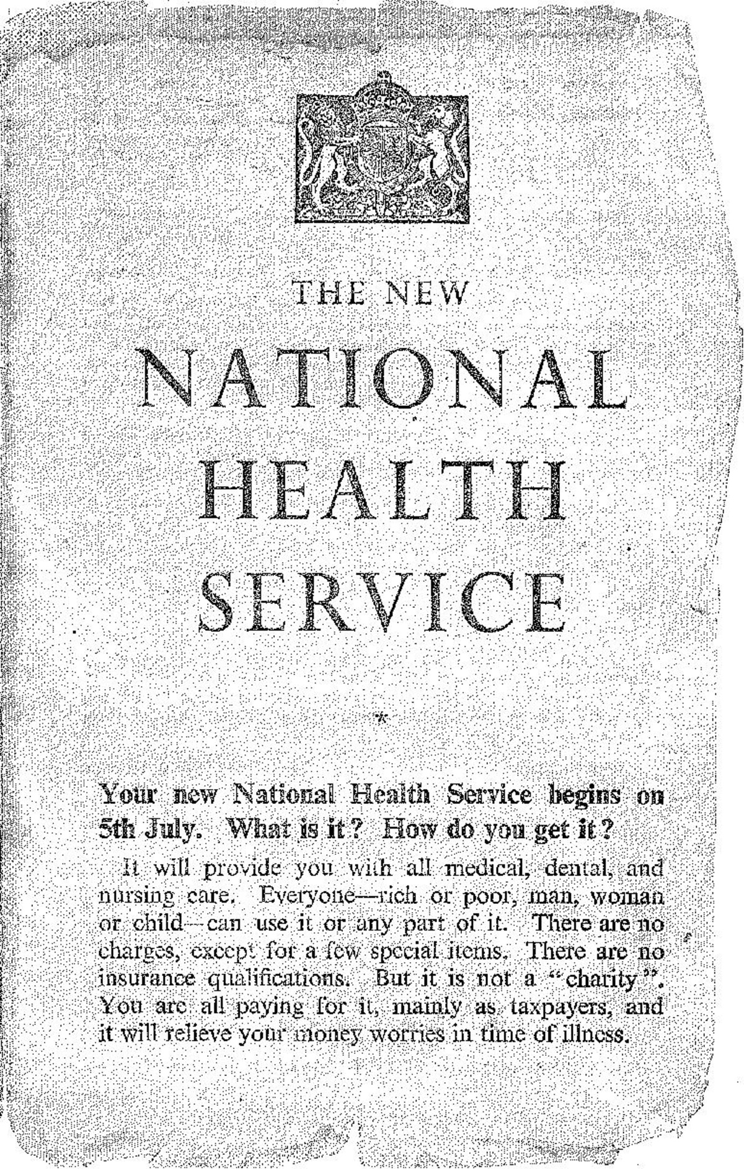
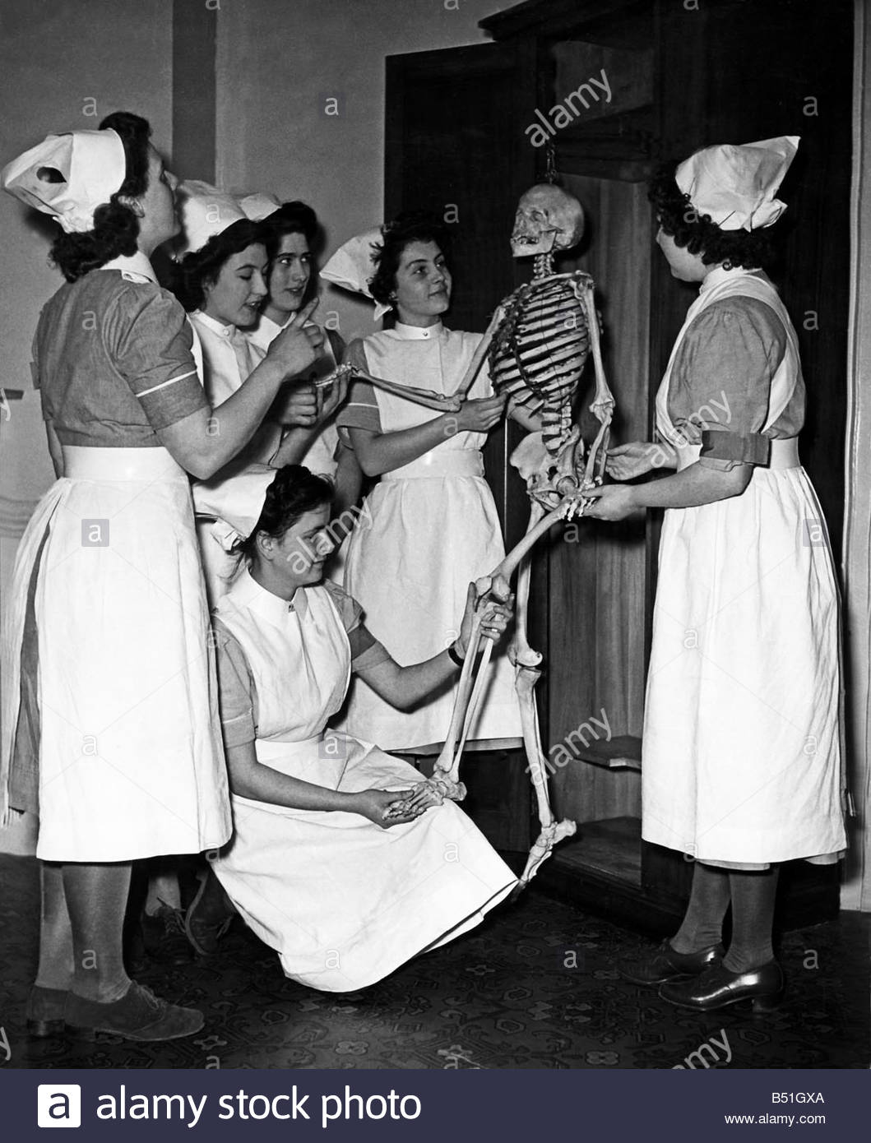
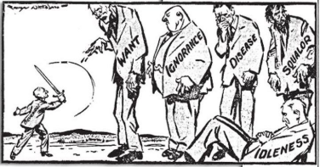
Task 1: History of the NHS
Write a report or produce a video presentation on the history of the NHS.
Include sections on:
Healthcare before the NHS
When/ why the NHS was introduced.
What the NHS does
Significance of the NHS in the UK.
How is the NHS different from other countries?
References for sources of information that you’ve used.
Stretch and Challenge: Evaluate the NHS’s role in maintaining a healthy society.
The Beveridge Report, 1942
In 1942, a plan had been presented by William Beveridge, a senior civil servant, detailing key areas for post-war reconstruction, aimed at establishing a national system of welfare for the people. It identified ‘five giants’ that were to be overcome: want, disease, ignorance, squalor and idleness.
When the Beveridge Report first appeared, it was welcomed by all the parties. There was broad agreement that protection needed to be provided for all members of society, and so when Labour came to power in 1945, they implemented the proposals in this report, thereby establishing the welfare state, a system which all governments after 1951 accepted in its essentials. This common acceptance became known as consensus.
Giant | The 1945 Labour Government’s Solution
Want | To be ended by National Insurance. The National Insurance Act created a system whereby the government, employers and employees all paid for insurance which would pay out in the event of unemployment, sickness, maternity and retirement.
Disease | To be ended by a comprehensive health service. The National Heath Service Act provided free medical and hospital treatment for all (the NHS).
Ignorance | To be ended by an effective education system. The Labour Party continued to support the Conservative’s 1944 Butler Education Act which provided free education within grammar schools, technical schools or secondary schools.
Squalor | To be ended by slum clearance and rehousing
Idleness | To be ended by full employment
The idealism that inspired the government’s welfare programme came at a heavy financial cost, which added to the financial burdens it inherited in 1945.

Slide 2
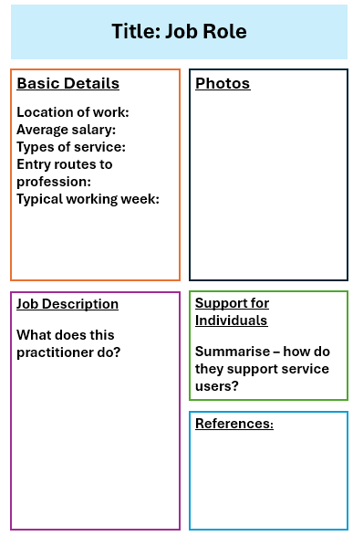
Task 2: Job roles in Health and Social Care
The Health and Social Care sector employs more than 3 million people in the UK.
There are many Health and Social Care settings, and a huge variety of roles for staff.
Research 5 of the following job-roles within Health and Social Care and produce a fact-file on each one.
Stretch and Challenge: Research and mind-map the care values of practitioners.
Job Roles:
General Practitioner
District Nurse
Optician
Pharmacist
Dentist
Dental Hygienist
Paramedic
Surgeon
Radiographer
Cardiologist
Anaesthetist
Dermatologist
Healthcare Associate
Physician Associate
Palliative Care Worker
Dietician
Rehabilitation Worker
Midwife
Health Visitor
Paediatrician
School Nurse
Youth Worker
Social Worker
Family Support Worker
Foster Carer
Occupational Therapist
Physiotherapist
Podiatrist
Osteopath
Wheelchair Technician
Hospital Transport Driver
Mental Health Nurse
Counsellor
Clinal Psychologist
Care manager
Carer
Speech and Language Therapist
Social Prescriber
Example Fact file:

Slide 3
Task 3: Essential Vocabulary
Research and define the following keywords.
Summarise each keyword with a picture/drawing to help you remember it.
Stretch and Challenge: Write a paragraph that uses all of the keywords.
Term | Definition | Pic/image/draw
Adolescence
Advocate
Attachment
Care package
Safeguarding
Discrimination
Diversity
Empathy
Ethical

Slide 4
Term | Definition | Pic/image/draw
Person-centred care
Prejudice
Care values
Holistic Approach
Multi-disciplinary team
Physiology
Legislation
Risk Assessment
Empowerment
Self-Esteem

Slide 5
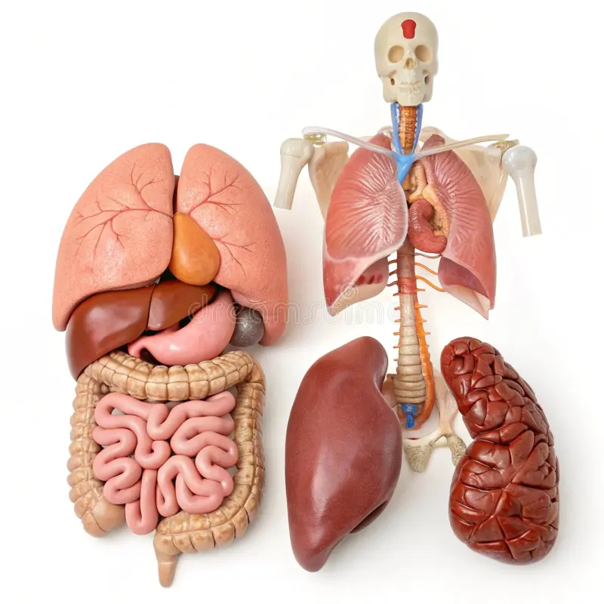
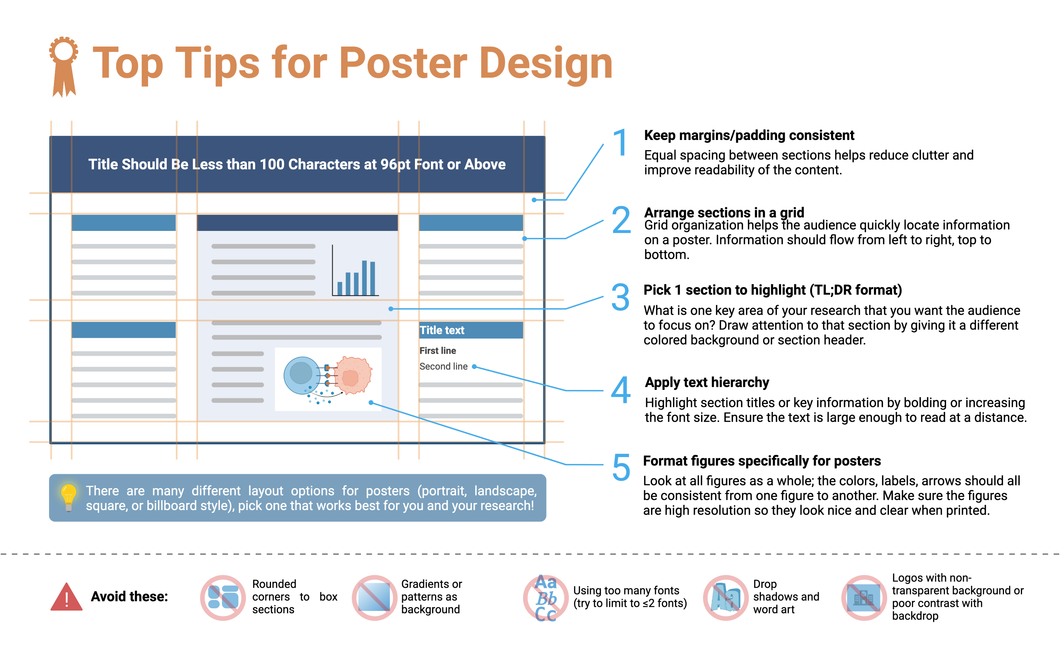
Task 4: The Human Body and Health
Create a poster on one of the main organ systems of the body.
On your poster, include:
A labelled diagram of the organ system.
Structure and function of each organ within the system.
The role of the organ system in the human body.
Steps that individuals can take to maintain the health of the organ system.
2 common medical conditions that can affect that organ system, including causes, signs/symptoms and the treatments available.
.
Organ Systems
Digestive System
Reproductive System
Cardiovascular System
Respiratory System
Nervous System
Endocrine System
Stretch and Challenge: Explain how the organ system works with other organ systems to maintain homeostasis.

Slide 6


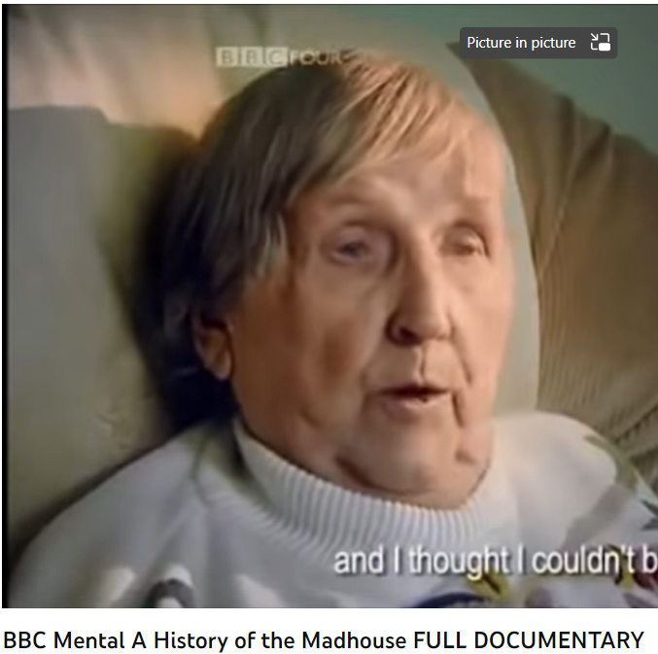
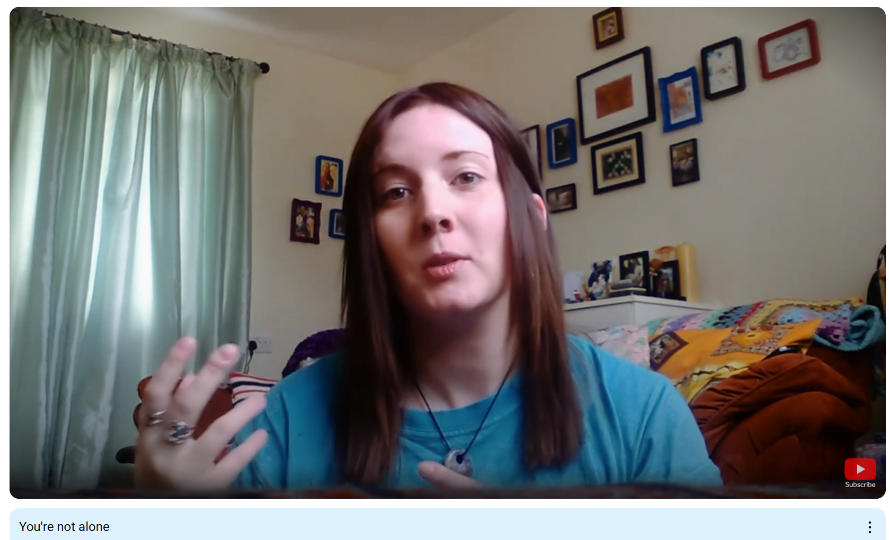
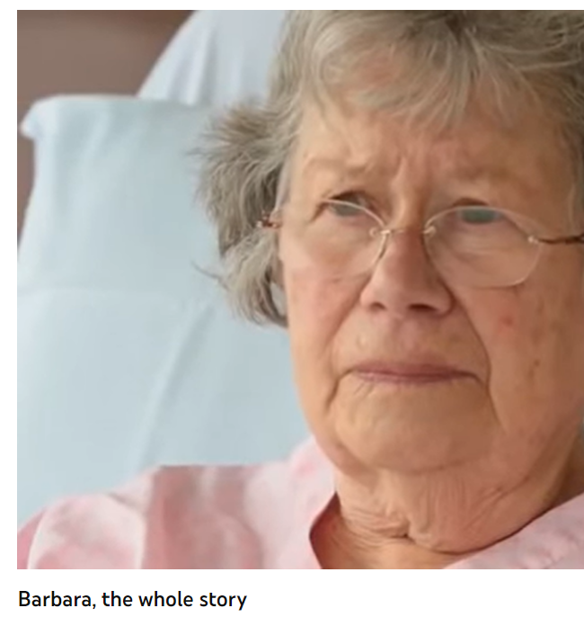
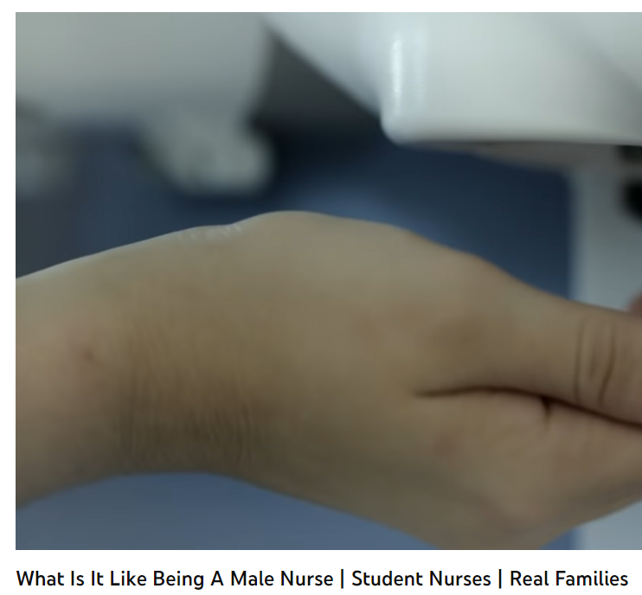
Task 5: Wider Knowledge
It is important to have a broad understanding of health care and social issues which affect services and professionals working for the NHS. One way of raising your awareness is to prepare you before your course starts with summer learning using different forms of media.
Your task is to pick…
➢ 2 Films
➢ 1 Book
➢ 2 Documentaries
You are then tasked with writing a report titled: ‘Discuss the issues [in the film/book or documentary] and the impacts on health care provision’
Specifications: minimum length - one A4 page, font size 11.
Include referencing as appropriate.
Some hints and tips to help you get started:
What issues, if any, are being raised? E.g. dementia
How does the film/book/documentary present health? E.g. care for people with dementia
Explain why the topic of the media source is relevant to your learning, and whether you think it is helpful and why?
This list is NOT exhaustive, there may be other questions/ideas you wish to consider as you watch or read – it would be lovely to share with us all.

Slide 7













What the Health
Louis Theroux: Extreme love, Dementia
Babies
Five Feet Apart
Theory of Everything
Humans;
Body Systems
Three identical strangers
Brain on Fire
The Game Changer (2018)
Girl, interrupted
Call the Midwife
13 Reasons Why
Recommended Watching for Health & Social

Slide 8


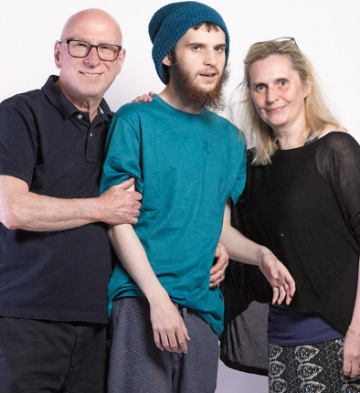



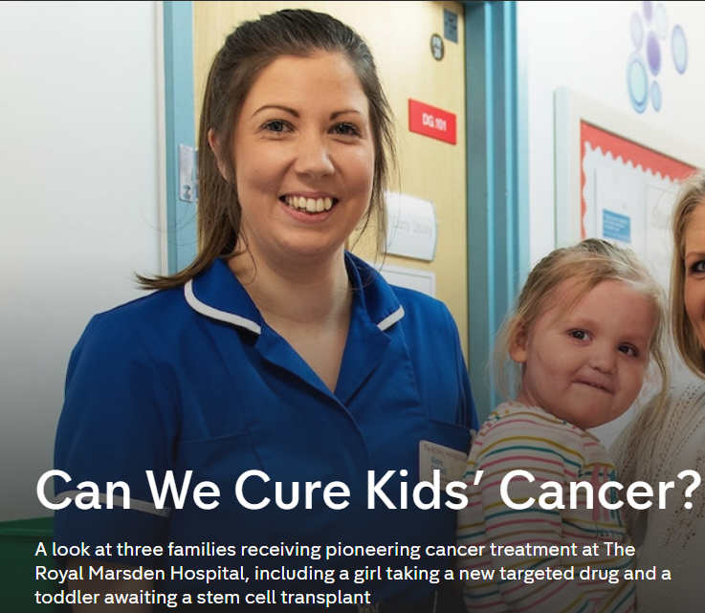





Not
Rhod Gilbert's Work Experience
Katie Price; Harvey and Me
Inside our Minds
Stacey Dooley 9-5 Care Home
BBC iPlayer
24 hours in A&E
Born to be different
The Royal Marsden
Losing it: Our mental health
All 4
Beyond weight loss
The Upside
ALLELUJAH
Miss you Already
Amazon Prime
No Netflix paid account

Slide 9





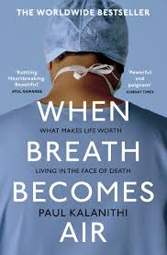





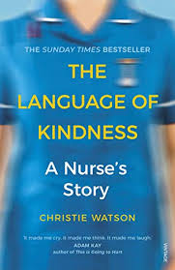


Dive into a book
Pig Heart Boy by Malorie Blackman
The Illustrated Mum Jacqueline Wilson
This is Going to Hurt by Adam Kay
When Breathe becomes Air by Paul Kalanithi
Further Reading
The Hate U Give by Angie Thomas
Me Before you by Jojo Moyes
The Fault in Our Stars by John Green
The Story of Baby P by Ray James
The Language of Kindness by Christie Watson
I am Malala by Malala Yousafzai
The Perks of Being a Wallflower Stephen Chbosky
Katie Price; Harvey
Recommended Reading for Health & Social Care
Yes, some of these are also films, if you prefer!

Slide 10



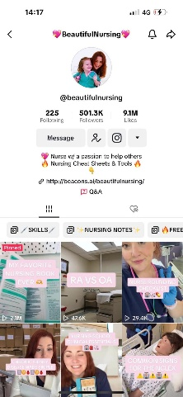

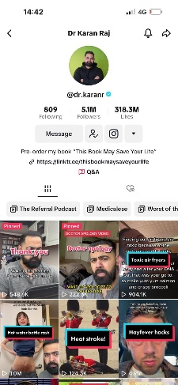
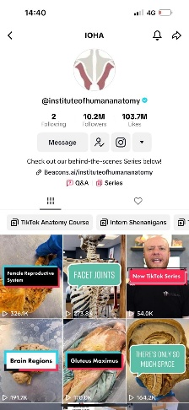

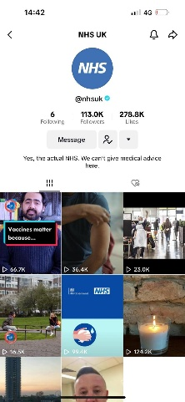


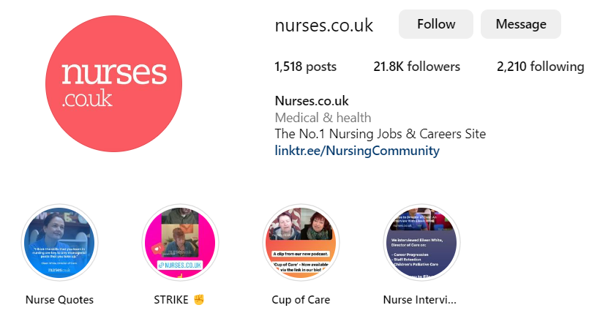
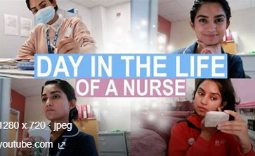
Social Media
Follow
Follow
@midwifemama
@beautifulnursing
@leilaincredible
@dr.karanr
@instituteofhumananatomy
@lubdubsblog
@nhsuk
@alliedhealthcareforme
Nurses.co.uk
@nursezara_uk
If you have any others, you think are good, let us know ☺

