Slide 1
You must select one from each category and write a reflection on their impact. Questions to consider in writing this:
● What was the message?
● What did you find interesting?
● What new information did you learn?
● What questions do you still have?
● How do you think it relates to A-level Sociology?
● What links are there to gender, age, ethnicity, or social class?
● Are there links to your topics?
How do I do it?
● Write a report on each category (A4 page is enough)
● Create a storyboard for each of these
● Create an A4 mind-map

Slide 2
Sociology Summer task
Choose at least one task from each box. These tasks will help to prepare you to begin the course and ensure you have chosen the subject wisely.
Compulsory listening: Studying sociology for the first time
Reading:
'Natives' by Akala
Invisible Women by Criado Perez
She Speaks By Yvette Cooper
Class & Education Diane Reay
When do gendered roles within the family start?
What About Men? (Audio Download): Caitlin Moran, Caitlin Moran, Penguin Audio: Amazon.co.uk: Books
Listening:
Key terms if you're new to Soc
Education & the working class
Organised crime
Love Island
Gang leader for a day
Gender roles in the family
Watching:
American Son
Crime Files
Stacey Dooley Costa del Narcos
Being Black and British
Is uni racist?
21 Up a study of growing up
The wisdom of sociology
The relationship between Capitalism and the Patriarchy (STUDENT TAKEOVER) (youtube.com)
Purchase your textbook and ensure your device is sixth form ready.
It is also useful to obtain some flashcards, coloured paper and a whiteboard pen.

Slide 3
Sociology Summer task
Studying sociology for the first time
I read_______________________
Summary:
I listened to ______________
Summary:
I watched:__________________
Summary:

Slide 4
Additional reading to support textbooks include: Speak with Yr13 students to see if they are selling any of their copies

Slide 5
Read through the following slides and familiarise yourself with the structures and style of questions that the three papers will test you on. Look for similarities between subjects and approaches for you GCSE’s. You will have support in class to adapt to the exam requirements.

Slide 6
Paper One Structures

Slide 9
6 Marker – 6 minutes
AO1: 2 marks | AO2: 4 marks
Knowledge & Understanding | Application
What you know and understand about sociology | How you use your knowledge of sociology to answer the question
One paragraph
Paragraph 1 | Start off by explaining what the key concept is and then give at least one piece of sociological evidence (study, theory) and at least two examples
Example Question
Explain, using examples, the concept of high culture (6)

Slide 10
12 Marker – 12 minutes
Two paragraphs
AO1: 4 marks | AO2: 8 marks
Knowledge & Understanding | Application
What you know and understand about sociology | How you use your knowledge of sociology to answer the question
Paragraph 1 PEEE | Use Source A to make a point Back your point up with sociological evidence (studies, theory) Then explain how your evidence links to your point (using concepts) Finish your paragraph off my providing an example (contemporary evidence)
Paragraph 2 PEEE | Use Source B to make a point Back your point up with sociological evidence (studies, theory) Then explain how your evidence links to your point (using concepts) Finish your paragraph off my providing an example (contemporary evidence)
Example Question
Using Sources A and B and your wider sociological knowledge, explain the concept of global culture. (12)
McLuhan
Mcdonalds
Hall
Travel, internet?

Slide 11
20 Marker – 20 minutes
Paragraph 1 PEEE | Argument to support the question PEEEE
Paragraph 2 PEEE | Argument to support the question PEEE
Paragraph 3 PEEE | Argument to support the question PEEE
Paragraph 4 PEEE | Evaluation PEEE
Conclusion | A critical conclusion that is fully supported, backed up with some more sociological evidence
AO1: 8 marks | AO2: 8 marks | AO3: 4 marks
Knowledge & Understanding | Application | Analysis & Evaluation
What you know and understand about sociology | How you use your knowledge of sociology to answer the question | Your ability to use sociology to present both sides of an argument
Outline and briefly evaluate the view that nurture is a stronger influence than nature

Slide 12
Paper Two Structures

Slide 15
Researching and Understanding Social Inequalities Exam Paper
Marks and Timings
 | Section A |  |  |  |  | Section B
Marks | 45 Marks |  |  |  |  | 60 Marks
Timings | 60 minutes |  |  |  |  | 1 Hour 15 minutes
Breakdown of timings | Source Analysis | Q1 4 marks | Q2 6marks | Q3 10 marks | Q4 25 marks | Q5 20 marks | Q6 40 marks
 | 5 mins | 5 mins | 8 mins | 12 mins | 30 mins | 25 mins | 50 mins
You will need to get used to answering these questions under timed conditions. Time is tight in the exam and half the battle is sticking to timings!

Slide 16
4 Marker – 5 minutes
AO2: 4 marks
Application
How you use your knowledge of sociology to answer the question
One paragraph
Paragraph 1 | You should make 3-4 observations about the data shown. Each observation should be distinct and backed up with evidence from the source.
Example Question
Summarise the data shown in Source A. (4)
To get 4/4 you need to: “show an excellent ability by clearly and accurately summarising the data in Source A”.

Slide 17
6 Marker – 8 minutes
AO1: 2 marks | AO2: 4 marks
Knowledge & Understanding | Application
What you know and understand about sociology | How you use your knowledge of sociology to answer the question
Two paragraphs
Example Question
Explain two possible problems with the representativeness of the samples used in the research
summarised in Source B.. (6)
Paragraph 1 | Outline one problem backed up with evidence from the source
Paragraph 2 | Another problem backed up with evidence from the source

Slide 18
10 Marker – 12 minutes
Two paragraphs
AO2: 4 marks | AO3: 6 marks
Application | Analysis & Evaluation
How you use your knowledge of sociology to answer the question | Your ability to use sociology to present both sides of an argument
Paragraph 1 PEEE | P: Clearly state one strength of the method and link to a concept E: Provide some evidence from the Source E: Develop your point by explaining the concept. E: Provide an example of how this affects the study of inequalities specific to the source.
Paragraph 2 PEEE | P: Clearly state one weakness of the method and link to a concept E: Provide some evidence from the Source E: Develop your point by explaining the concept. E: Provide an example of how this affects the study of inequalities specific to the source.
Example Question
With reference to Source A, explain one advantage and one disadvantage of sociologists using
quantitative data to study poverty. (10)
Read question carefully. It could be 2 strengths…or 2 weaknesses!

Slide 19
25 Marker – 30 minutes
Six paragraphs
Introduction | Outline and explain the method
Paragraph 2 PEEE | Strength of the method Link to a concept /theory Link to the source.
Paragraph 3 PEEE | Weakness of method Link to a concept /theory Link to the source.
Paragraph 4 PEEE | Strength of the method Link to a concept /theory Link to the source.
Paragraph 5 PEEE | Weakness of method Link to a concept /theory Link to the source. .
Conclusion | A critical conclusion that is fully supported, backed up with some more sociological evidence
AO1: 5 marks | AO2: 5 marks | AO3: 15 marks
Knowledge & Understanding | Application | Analysis & Evaluation
What you know and understand about sociology | How you use your knowledge of sociology to answer the question | Your ability to use sociology to present both sides of an argument
Example Question
Using Source B and your wider sociological knowledge, explain and evaluate the use of a combination of questionnaires and in-depth interviews for researching women’s involvement in
digital gaming.. (25)
Each PEEE paragraph should contain:
A clear point that is related to the question
Supporting evidence (theory/study/source)
Detailed explanation using key concepts
An illustrative example (contemporary evidence)

Slide 20
20 Marker – 25 minutes
Five paragraphs
AO1: 12 marks | AO2: 8 marks
Knowledge & Understanding | Application
What you know and understand about sociology | How you use your knowledge of sociology to answer the question
Introduction | Outline and explain the concepts in the question.
Paragraph 1 PEEE | Provide one way...
Paragraph 2 PEEE | Provide a second way...
Paragraph 3 PEEE | Provide a third way...
Paragraph 4 PEEE | Provide a fourth way...
Example Question
Outline ways that social class may impact on a person’s life chances. (20)
Each PEEE paragraph should contain:
A clear point that is related to the question and completely separate to the previous point
Supporting evidence (theory/study)
Detailed explanation using key concepts
An illustrative example (contemporary evidence)

Slide 21
40 Marker
50 Minutes
Introduction | Outline why this issue is important to sociologists, define terms
Paragraph 1 PEEE | Argument to support the statement
Paragraph 2 PEEE | Argument against the statement
Paragraph 3 PEEE | Argument to support the statement
Paragraph 4 PEEE | Argument against the statement
Paragraph 5 PEEE | Argument to support the statement
Paragraph 6 PEEE | Argument against the statement
Conclusion | Conclusion summary
AO1: 16 marks | AO2: 8 marks | AO3: 16 marks
Knowledge & Understanding | Application | Analysis & Evaluation
Argue for, theories and studies | Link to question | Argue against, theory and studies, conclude
Example Question
Assess the view that class inequality can be a positive thing for society. (40 marks)
Eight paragraphs
Each PEEE paragraph should contain:
A clear point that is related to the question
Supporting evidence (theory and a study)
Detailed explanation using key concepts
An illustrative example (contemporary evidence)

Slide 22
Paper Three Structures

Slide 23
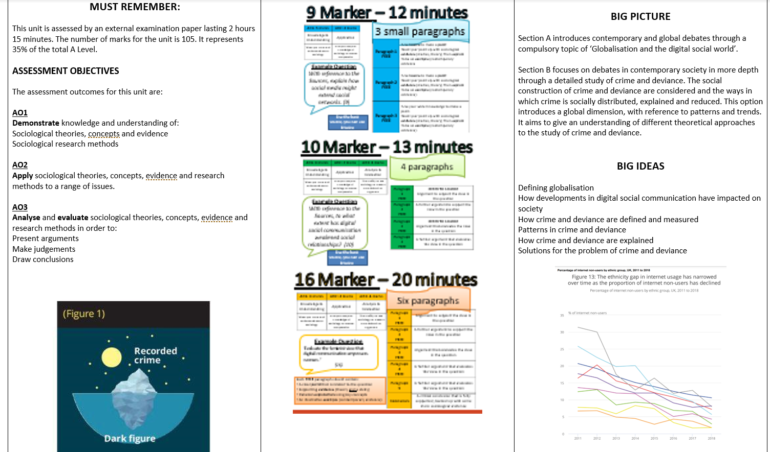

Slide 24
