Slide 1
Alternative Academic Qualification (AAQ) Health & Social Care
Introduction to Sixth Form
Name: ______________________

Slide 2
Contents
What will I be studying? Page 3
Recommended Netflix Programmes Page 4
Other recommended watching Page 5
Recommended Reading Page 6
Recommended social media Page 7
Representations Task Page 8
Learning Log Page 9
Keyword Glossary Task Page 10-11
A-Z Challenge Page 12
Information Leaflet Task Page 13
History of the NHS Page 14
Roles in Health and Social Care Page 15
Extension Task Page 16
Checklist for September Page 17

Slide 3
What will I be studying?
Health and social care covers a wide range of topics area, and provides a good foundation for a wide range of careers.
In general, our subject is about people, their health and wellbeing, their circumstances and the effects of life events.
Your learning will explore the role of health and social care services in our society, the values and principles of workers in these sectors, and the complexities of maintaining health and wellbeing in our society.
To gain the Extended Certificate in Health and Social Care, over the next two years, you will study the following
Examined Units:
F090 Principles of Health and Social Care
F091 Anatomy and Physiology for Health and Social Care
Coursework Units:
F092 Person-centred Approach to Care.
F093 Supporting People with Mental Health Conditions.
In addition, you will also study two of the following coursework units:
F094 Supporting People with Long-Term Physiological Conditions
F095 Investigating Public Health
F096 Supporting People in Relation to Sexual Health, Pregnancy and Post-Natal Health.
F097 Supporting Health Nutrition and Lifestyles.

Slide 4
What the Health
Louis Theroux: Extreme love, Dementia
Babies
Five Feet Apart
Theory of Everything
Humans;
Body Systems
Three identical strangers
Brain on Fire
The Game Changer (2018)
Girl, interrupted
Call the Midwife
13 Reasons Why
Recommended Watching for Health & Social

Slide 5
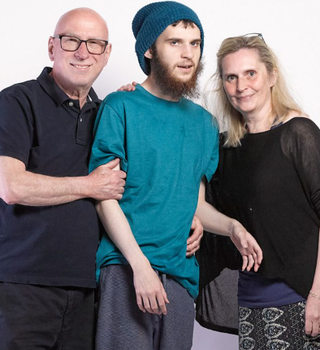
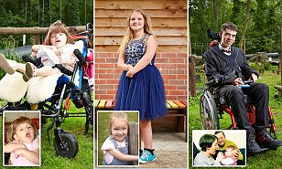
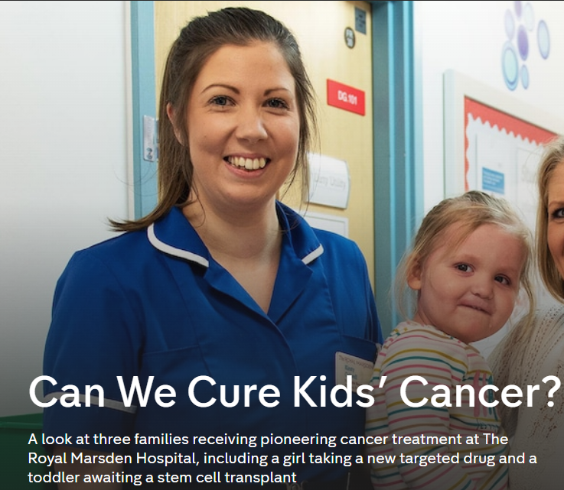
Not
Rhod Gilbert's Work Experience
Katie Price; Harvey and Me
Inside our Minds
Stacey Dooley 9-5 Care Home
BBC iPlayer
24 hours in A&E
Born to be different
The Royal Marsden
Losing it: Our mental health
All 4
Beyond weight loss
The Upside
ALLELUJAH
Miss you Already
Amazon Prime
No Netflix paid account

Slide 6
Dive into a book
Pig Heart Boy by Malorie Blackman
The Illustrated Mum Jacqueline Wilson
This is Going to Hurt by Adam Kay
When Breathe becomes Air by Paul Kalanithi
Further Reading
The Hate U Give by Angie Thomas
Me Before you by Jojo Moyes
The Fault in Our Stars by John Green
The Story of Baby P by Ray James
The Language of Kindness by Christie Watson
I am Malala by Malala Yousafzai
The Perks of Being a Wallflower Stephen Chbosky
Katie Price; Harvey
Recommended Reading for Health & Social Care
Yes, some of these are also films, if you prefer!

Slide 7
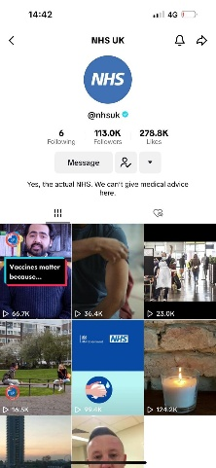
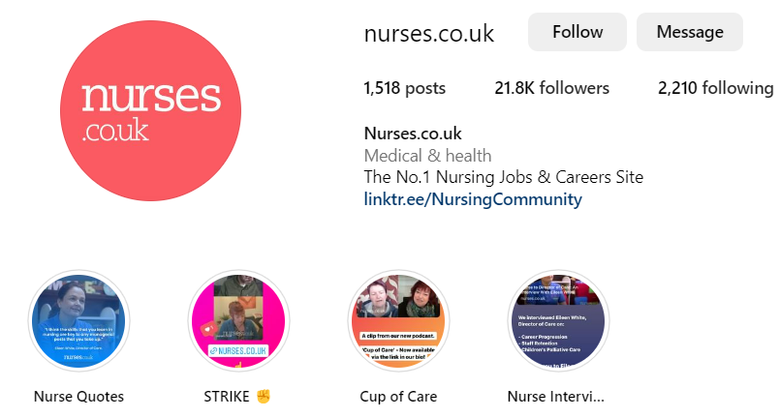
Social Media
Follow
Follow
@midwifemama
@beautifulnursing
@leilaincredible
@dr.karanr
@instituteofhumananatomy
@lubdubsblog
@nhsuk
@alliedhealthcareforme
Nurses.co.uk
@nursezara_uk
If you have any others, you think are good, let us know ☺

Slide 8
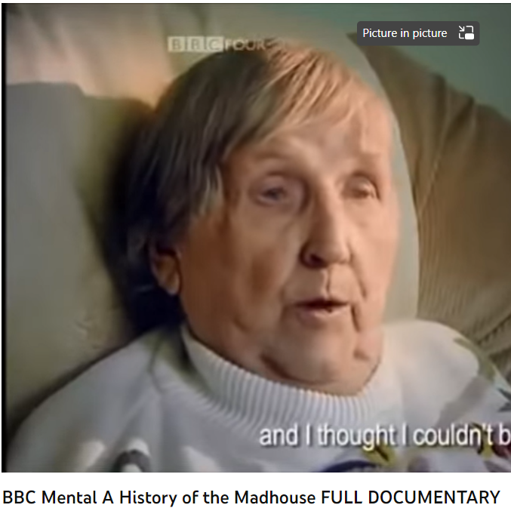
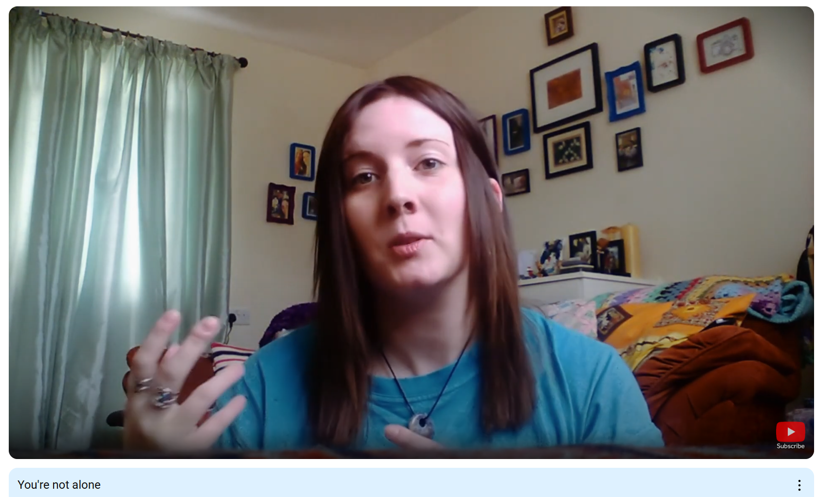
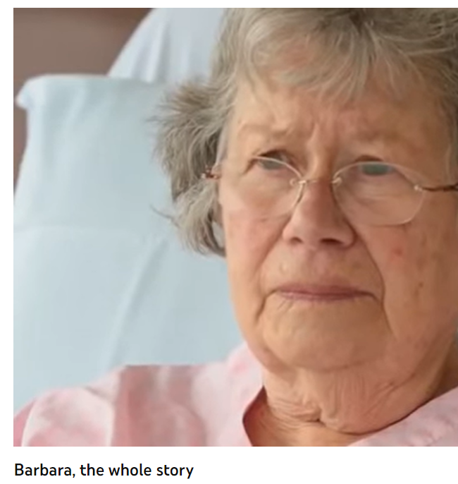
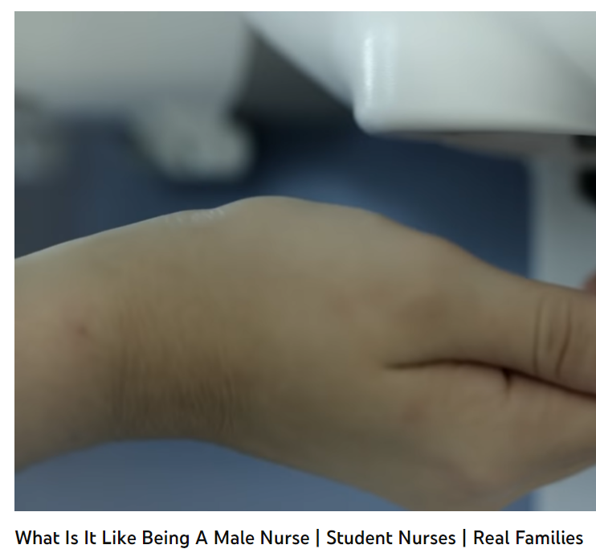
Health and Social Care in the Media
It is important to have a broad understanding of health care and social issues which affect services and professionals working for the NHS. One way of raising your awareness is to prepare you before your course starts with summer learning using different forms of media.
Your task is to pick…
➢ 2 Films
➢ 1 Book
➢ 2 Documentaries
You are then tasked with writing a report titled: ‘Discuss the issues [in the film/book or documentary] and the impacts on health care provision’
Specifications: minimum length - one A4 page, font size 11.
Include referencing as appropriate.
Some hints and tips to help you get started:
What issues, if any, are being raised? E.g. dementia
How does the film/book/documentary present health? E.g. care for people with dementia
Explain why the topic of the media source is relevant to your learning, and whether you think it is helpful and why?
This list is NOT exhaustive there may be other questions/ideas you wish to consider as you watch or read – it would be lovely to share with us all.

Slide 9
Learning Log
Record here any additional reading/viewing you are undertaking in order to show what you have been completing to prepare you for the course.
Use the lists on the previous pages for guidance on what you could you watch/read/research
Date | Title | Summary of content | My thoughts

Slide 10
Task: Research and define the following keywords.
Summarise each keyword with a picture/drawing to help you remember it.
Term | Definition | Pic/image/draw
Adolescence
Advocate
Attachment
Care package
Safeguarding
Discrimination
Diversity
Empathy
Ethical

Slide 11
Term | Definition | Pic/image/draw
Person-centred care
Care values
Holistic Approach
Multi-disciplinary team
Physiology
Health and care legislation
Risk Assessment
Meeting people’s needs
Self-Esteem

Slide 12
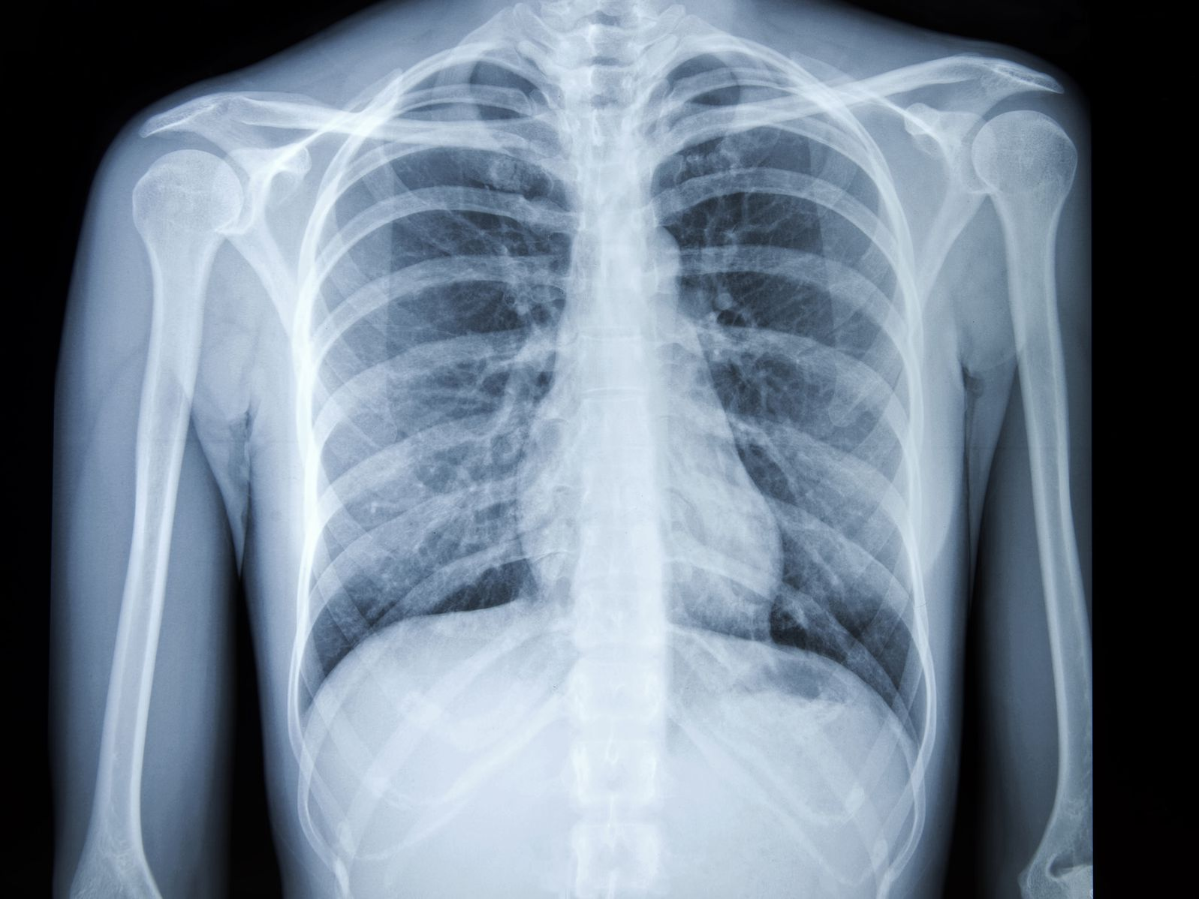
Task: Research a list of Health and Social Care jobs/ medical terms for each letter of the alphabet
A
B
C
D
E
F
G
H
I
J
K
L
M
N
O
P
Q
R
S
T
U
V
W
X
Y
Z

Slide 13
Information Leaflet Task
Choose one of the below
Research the government recommendations for the below lifestyle factors and produce and educational information leaflet on how to live a healthy life.
Alcohol units
Exercise
Hydration
Nutritional diet
Sleep
Smoking
Prescription and illegal drugs
Research different techniques to manage stress, worries and anxieties and produce an educational leaflet on how to maintain good mental health.
Grounding
Breathing exercises
Me time and saying no
Meditation
Avoid unhealthy habits

Slide 14
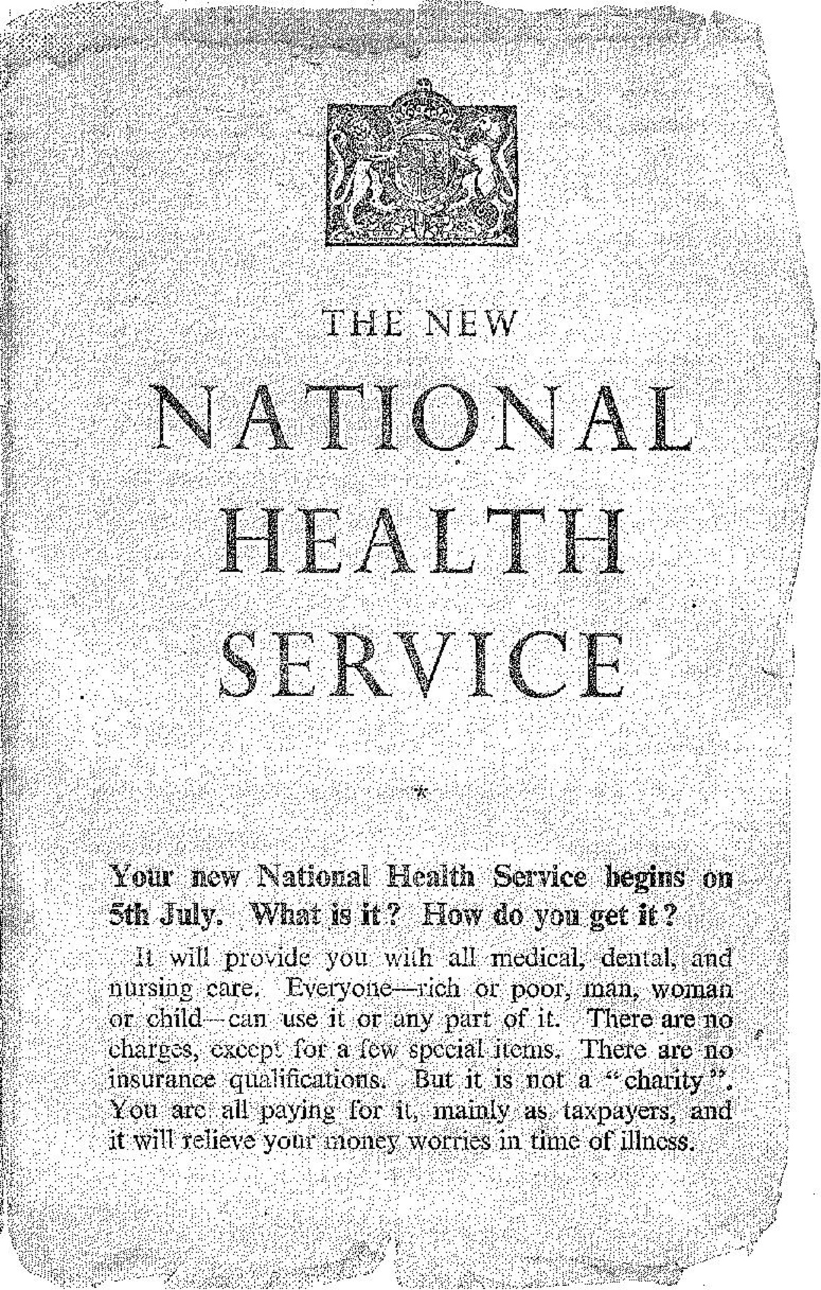
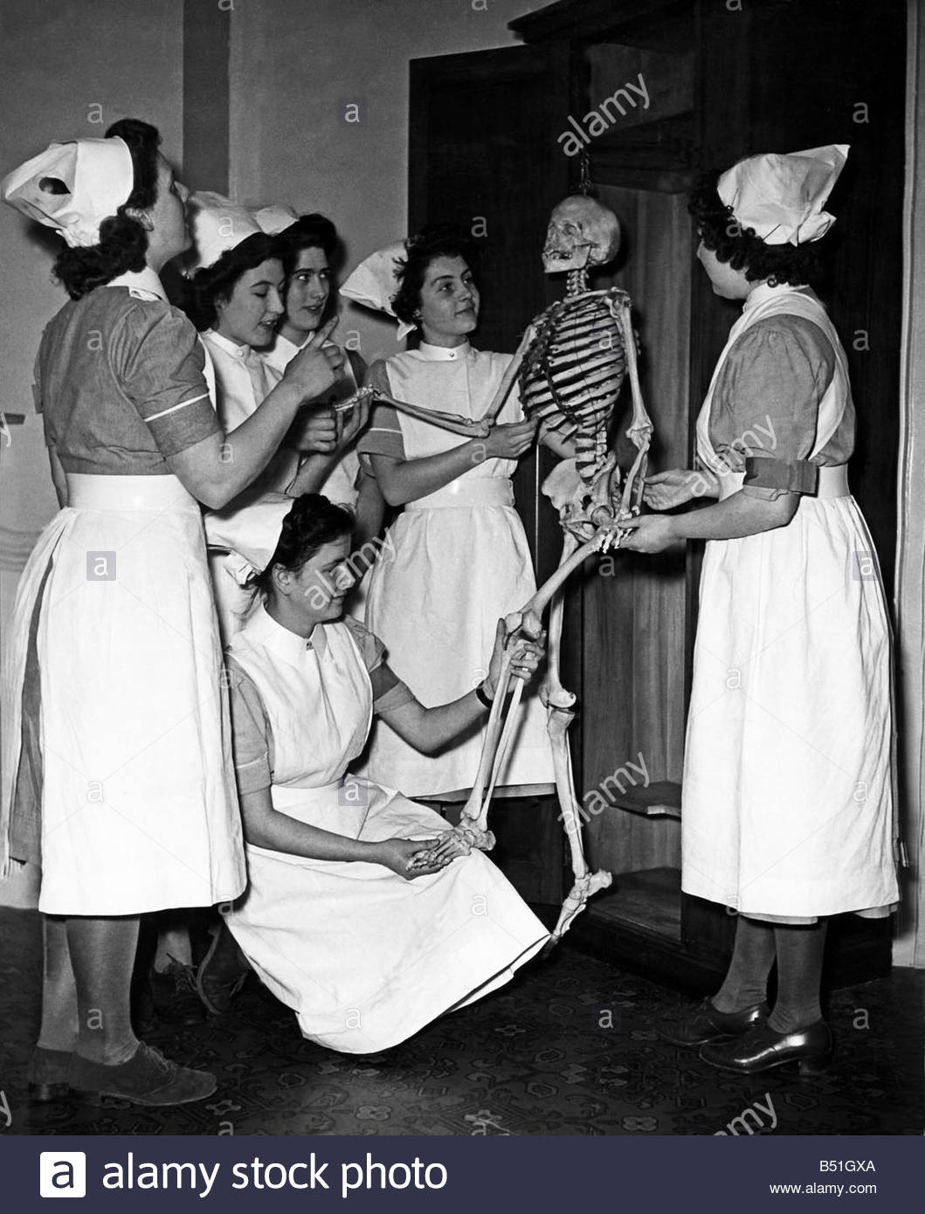
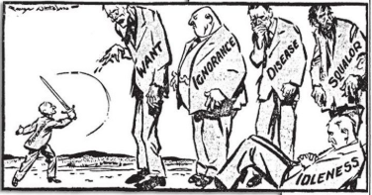
History of the NHS
Write a report or produce a video presentation on the history of the NHS.
Include sections on:
Healthcare before the NHS
When/ why the NHS was introduced.
What the NHS does
Significance of the NHS in the UK.
How is the NHS different from other countries?
References for sources of information that you’ve used.
Some information is below to help you.
The Beveridge Report, 1942
In 1942, a plan had been presented by William Beveridge, a senior civil servant, detailing key areas for post-war reconstruction, aimed at establishing a national system of welfare for the people. It identified ‘five giants’ that were to be overcome: want, disease, ignorance, squalor and idleness.
When the Beveridge Report first appeared, it was welcomed by all the parties. There was broad agreement that protection needed to be provided for all members of society, and so when Labour came to power in 1945, they implemented the proposals in this report, thereby establishing the welfare state, a system which all governments after 1951 accepted in its essentials. This common acceptance became known as consensus.
Giant | The 1945 Labour Government’s Solution
Want | To be ended by National Insurance. The National Insurance Act created a system whereby the government, employers and employees all paid for insurance which would pay out in the event of unemployment, sickness, maternity and retirement.
Disease | To be ended by a comprehensive health service. The National Heath Service Act provided free medical and hospital treatment for all (the NHS).
Ignorance | To be ended by an effective education system. The Labour Party continued to support the Conservative’s 1944 Butler Education Act which provided free education within grammar schools, technical schools or secondary schools.
Squalor | To be ended by slum clearance and rehousing
Idleness | To be ended by full employment
The idealism that inspired the government’s welfare programme came at a heavy financial cost, which added to the financial burdens it inherited in 1945.

Slide 15
On ‘The front line’…….
What does it mean when people talk about being ‘on the front line’?
What does it mean when people talk about multidisciplinary teamwork?
Research the following job roles and fill in the table.
Job Role | Definition | Roles and Responsibilities
District Nurse
Auxiliary Nurse
Palliative Care
Phlebotomist
Domiciliary Carer
Neonatal nurse

Slide 16
True or False?
Colour code the statements in order to show if they are true or false.
True False
A palliative care nurse will get involved with everyone who gets coronavirus.
A district nurse will only work with the elderly.
A midwife works with babies and children up to 5 years
Domiciliary carers provide care in the home.
Only phlebotomists are allowed to take blood.
Auxiliary nurses help support other nurses to do their roles.

Slide 17
Passport to Sixth Form Check list
Use this list to make sure you have everything completed and ready to hand in on 2nd September 2025.
1 page report/review on your chosen film, documentary and book, page 8.
Complete at least a minimum of 5 sections of the learning log, page 9.
Completed glossary of key terms, pages 10-11.
Filled in A-Z of Health and Social Care, page 12.
Completed Information leaflet, page 13
Report/video on the History of the NHS with all sections complete, page 14
Job roles in H&SC research and table complete, page 14
True and False activity, page 15.
If you need support with any of the tasks, please email:
Mrs Procter – aprocter@ormistonriversacademy.co.uk
Miss Welham – ewelham@ormistonriversacademy.co.uk
We look forward to
seeing you in September!

