Slide 1
Transition Booklet Parent/Carer Guide

Slide 2
Being ready for Year 7!
Welcome to Ormiston Rivers Academy
Year 6 is a very exciting year of your child’s education. The children are on the verge of becoming young adults, developing their inquisitive minds and preparing to make new friends.
At Ormiston Rivers Academy we aim to encourage them to develop into outstanding learners through ‘Deepening Learning, raising aspiration': by showing a positive attitude through our AIRR Values.
For children to feel ready for life at secondary school it is essential that they should reflect on their own strengths, celebrate these and recognise how they learn best. They should also know their areas for development, ask for help when needed, and recognise ways in which they can support themselves to make progress. The most successful children show resilience and are aspirational.
We also hope you will join us in supporting your child as we help them to achieve their potential.

Slide 3
Welcome from Mr Shanahan Head of Year 7
Welcome to Ormiston Rivers Academy, I will be the Head of Year 7!
There will be a mixture of feelings and emotions as your child begins the academic year, embarking on the next stage of their journey in education. Rest assured that will be the same for me, as I am also new to Ormiston Rivers, doing a job that I have undertaken previously and which I’m very passionate about.
Aspiration, Independence, Resilience and Respect are at the forefront of what takes place at Ormiston Rivers and as Head of Year I will be championing these key values daily. As a school and as the Head of Year, we have very high standards and it is important we work together, to get the very best out of all our students.
The school policies on a variety of different aspects linked to our pupil’s education, safety and wellbeing can be found on the school website. I will be using and following these consistently and rigorously and would encourage you to look at these, so we can continue to support your child here at Ormiston Rivers.
Academic success, making consistent progress in all subjects and enjoying learning are of paramount importance. What is equally as important is doing all we can to make sure that our young adults grow into becoming the best version of themselves, by having a positive impact in school and in society.
I am very much looking forward to working here and getting to know and support your child both inside and outside of the classroom environment. I have no doubt that I will be working alongside a supportive and dedicated staff body who will give their all every day to support each member of this year group. Your support working with us all, will be greatly appreciated.
Mr P Shanahan

Slide 4
Being ready to learn
Building Independence
We ask all students to make sure that they are ready to learn for all lessons​. This includes having their writing equipment, planners, reading books and calculators with them.
​
All form tutors and teachers will be checking at the start of every lesson. The school shop is open every day to purchase equipment too.
We are also aiming to reduce our plastic use in school and ask all students to bring in their own refillable water bottles each day.​

Slide 5
Uniform List
We want our students to wear their uniform with Pride. We have taken steps to make sure our uniform is affordable and practical as possible.
Academy Blazer with blue trim and Ormiston Rivers Academy Badge
Plain black school trousers or Academy tartan mock kilt, kilts should be no more than 5cm above the knee
Black socks or neutral plain tights
White school shirt that can be done up to the top button (long or short sleeves)
School clip on tie or normal tying tie for all students
Black leather school shoes – not Vanns, or canvas shoes/trainers.
Leggings are not permitted at all
Decorative belts, combat style trousers and cropped trousers are not permitted
Only the official Academy jumper is permitted, although this is no longer a compulsory item, sweatshirts and hoodies are not to be worn.

Slide 6
PE Uniform
Compulsory physical education uniform:
Black polo shirt with blue trim and Academy logo
Plain black shorts with Academy logo
Long black socks
Football/rugby boots
Training shoes with non-marking soles, not plimsolls, Vanns, Converse etc.
Shin pads for football
Optional P.E. items:
Plain back underlayers, to be worn underneath the compulsory P.E. kit (no logos)
ORA leggings

Slide 7
Safeguarding
Our Senior Designated Person is Ms Goodfellow, Assistant Vice-Principal
We also have a team of Student Support Assistants (SSAs) to report issues to. If you have any concerns about the welfare of any of the children within the school, please do speak with them.
When concerns are raised or noticed, we must make sure that any information is recorded. Parents will be contacted to discuss any concerns as soon as possible. On a few occasions, where there may be serious concerns, the information must be shared with our partners in the Police, Social Services and in Health as well. ​
Let your child’s form tutor or class teacher know if something has happened that means your child is upset or unhappy; or if there is something you feel we ought to know. This will enable us to support your child. The sooner we know there has been as issue the sooner we can resolve it.

Slide 8
Keeping Children safe
Travelling to and from school
Some children will be walking or cycling home from school. At primary school, students will have been taught about road safety, and may have done their cycling proficiency award. We will continue to discuss these themes, plus rail and water safety, and being safe in the local community. We work closely with the local policing team to support our students and will invite them into school to discuss these topics.
Children may be using the school bus for the first time. Check the times and locations of the pick-up/drop offs carefully – you may wish to practice getting the bus during the summer holiday. We work closely with the bus companies – they do have CCTV on each bus to monitor students' safety.

Slide 9
Internet Safety
Being safe online and when using social media – in school and at home
Within school we have strict filters on our computers that help block inappropriate sites for the children. The children are frequently reminded of Internet Safety Rules through the curriculum and assemblies, and we ask parents/carers to sign our Acceptable use Policy in students' planners.
We urge parents to keep a close eye on the internet usage that children access at home. Children may be using Social Media sites on their phones at home – we always advise parents/carers to monitor this and know their contacts and passwords.
We also encourage all students, parents and staff to use the Safer Schools App which we as a school have signed up to- this is rolled out for all year groups at the beginning of every academic year
Information for Parents can be found :
CEOP: www.ceop.gov.uk
Think U Know: www.thinkuknow.co.uk
Childnet: www.childnet-int.org

Slide 10
Parent Pay
Cashless payments
We use Parent Pay as our online payment portal
Details for your child's Parent Pay account will be sent out during the summer holidays
Parent Pay allows for cashless payments using a catering card
Catering cards will be issued on the Year 7's first day
To allow for a quick transition through the canteen and other catering outlets, it is essential that students remember their cards,
Replacement cards can be ordered via Parent Pay at a cost of £1
You can also purchase items of uniform i.e. a tie via Parent Pay

Slide 11
Useful Apps
SIMS, Go for Schools, Safer Schools App
This App will be introduced to Year 7 and parents/ carers in September. It links with advice for all when using social media and digital technology.

Slide 12
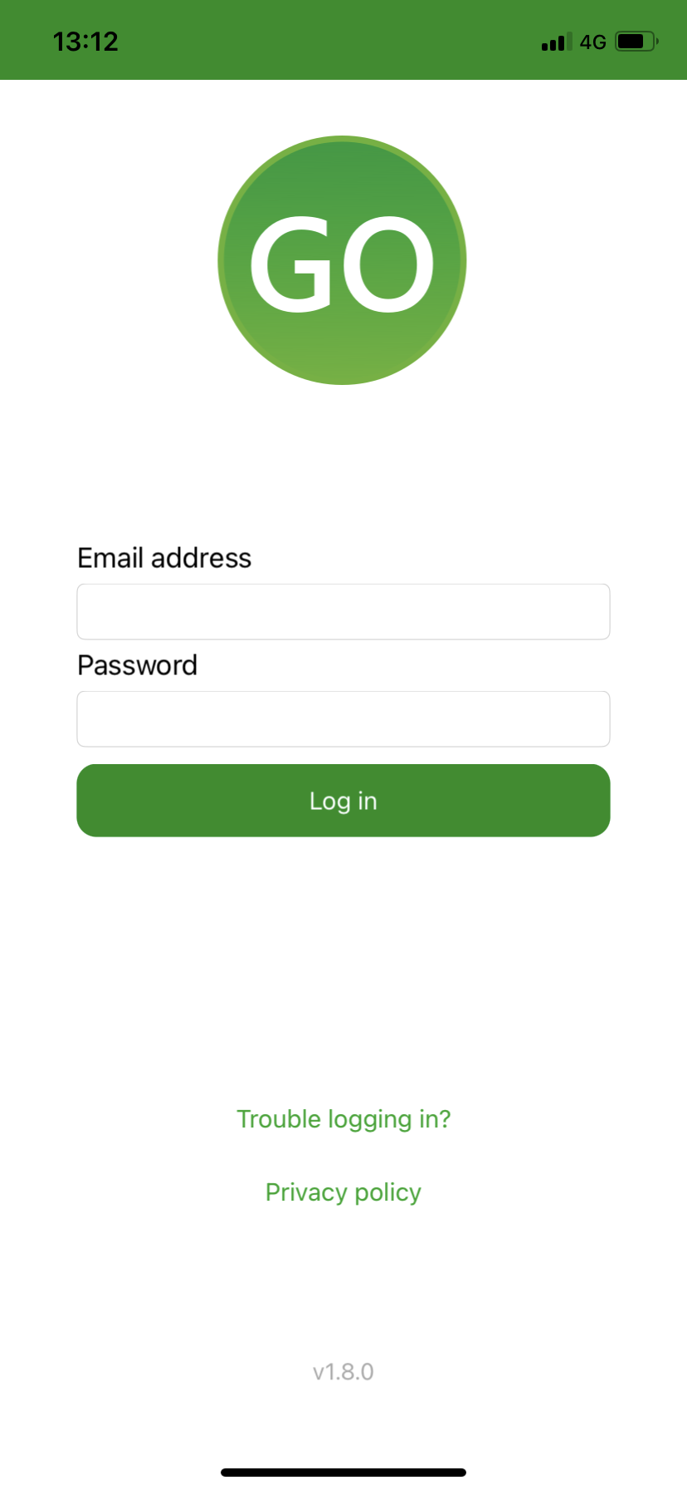
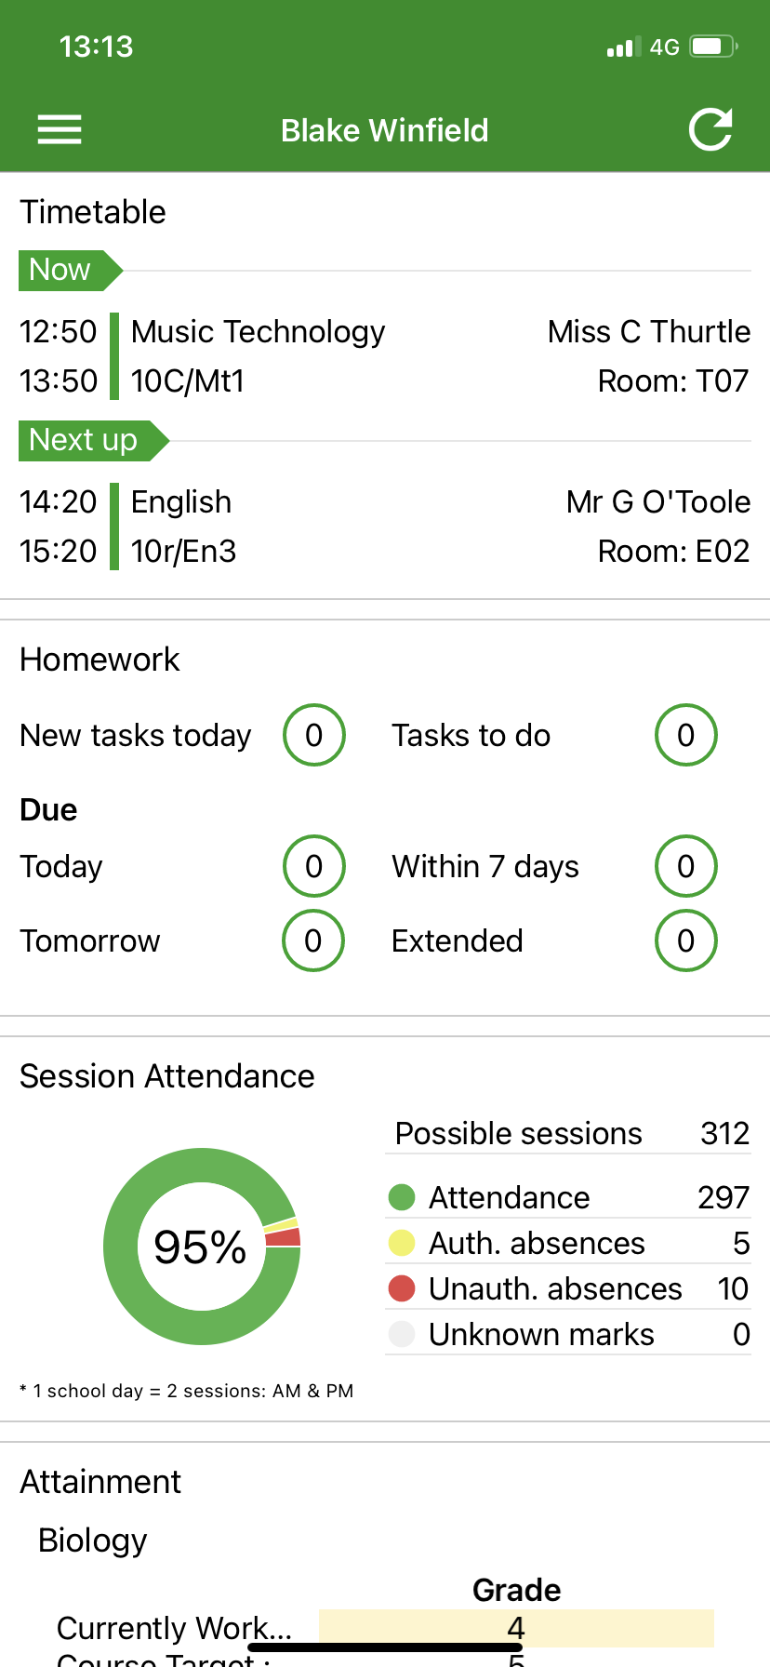
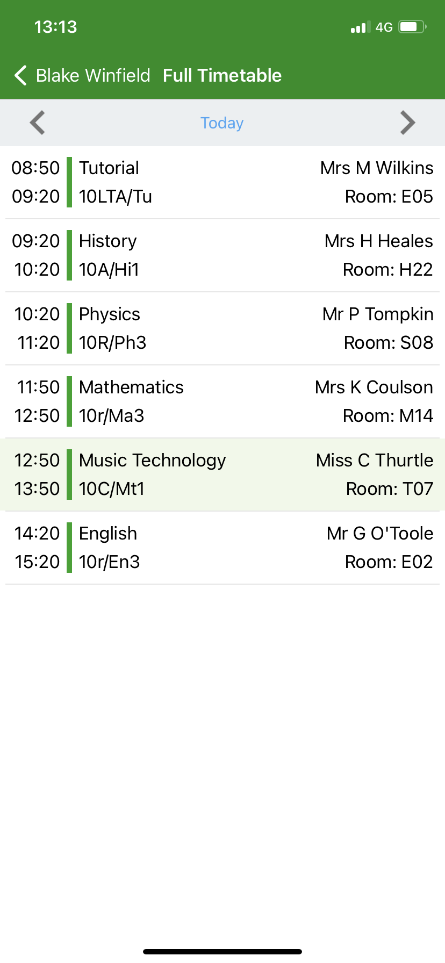
Go 4 Schools
Behaviour – Attendance – Timetables – Homework – Attainment – Detentions
Students and parents have access to all the above through www.Go4schools.com or by downloading the Go4schools app.
We recommend all students, parents and carers download the app and log in with the email account associated with the school (Student will be ORA email address as of September)

Slide 13
Supporting your child at home
English and Maths support
Research shows that home learning can have a positive impact upon learning when used in a focused way. The positive side is that:
Children become enthused when faced with investigative, open ended and practical home activities.
Parents can support where the school clearly links the home learning with school learning.
Children can rehearse essential skills.
Children can develop good learning behaviours.
Parents see the type of learning their child is doing at school.
Parents can see the quality of written work in the class books.

Slide 14
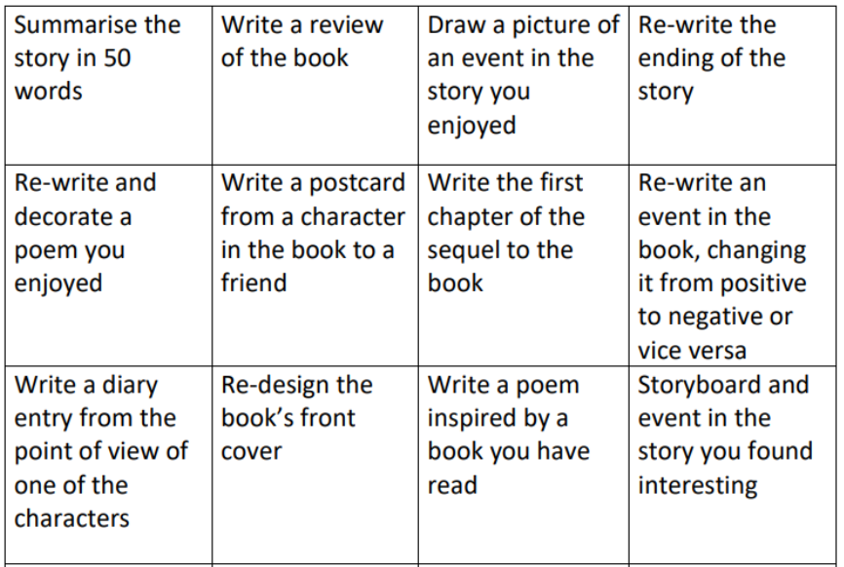
English Tips
We encourage frequent reading in school and ask all students to have a library book on them as part of their equipment.
Reading at home, like in Primary school, is still a useful way of develop your child's reading skills.
Here are some other ways in which you can evidence your reading and develop your literacy skills.
Most important of all; make reading with you as enjoyable as possible.

Slide 15
Maths Tips
One of the most valuable things that you can do is to talk to your child about their maths learning. Ask them what they have been learning and encourage them to explain. We all use maths in our everyday lives which means that there are plenty of opportunities to help your child with their maths learning by involving them in everyday activities.
Here are some possible ideas which you could use:
1) Count forwards and backwards in jumps of the same size (eg. 6, 7, 8, 9, 25) and so on. Physical activities such as skipping and playing catch could be incorporated to encourage motivation.
2) Talk about the shape of 2D and 3D objects and discuss their properties. Try and identify different examples of 2D and 3D shapes in the environment.
3) Ask your child to help when you are using money in practical, real-life contexts (eg. paying for items in a shop). Ask your child to work out how much the items might cost and how much change you might receive.
5) Ask your child to help with tasks such as measuring and weighing ingredients or when measuring the length or height of an object.
6) Help them to understand time, reading and interpreting both digital and analogue clocks. Involve them with dates/diaries. Ask them to calculate time intervals (eg. ‘We left the house at 9:55am and we returned at 3:35pm. How long were we out for?’).
7) Help your child to read and interpret timetables by asking them to use a magazine or the internet to find out about when TV programmes and/or films are on and how long they will last.
8) Ask your child to estimate the total price of items when shopping by rounding prices mentally to the nearest pound or ten pence.

Slide 16
Key Staff Contacts
Who to contact ...
Please call our Main Reception, 01621 782377 where our Receptionist will be able to direct your call to:
Mr P Shanahan – Head of Year 7
Mr D Marklew – Assistant Principal I/c Behaviour
Miss K Goodfellow – Assistant Principal/Designated Safeguarding Lead
Miss S Havard – SENDCo
Mrs C Scott – Deputy SENDCo
Mrs D Parry – Attendance Officer
Student Support Advisors: Mrs D Byford, Mrs T Sexton, Mrs L Corbett and Mr H Simpson
Mrs J Edwards – Admissions Officer & Admin. Support for Heads of Year/Mr Marklew
Mrs C Reed – Student Reception

