Slide 1
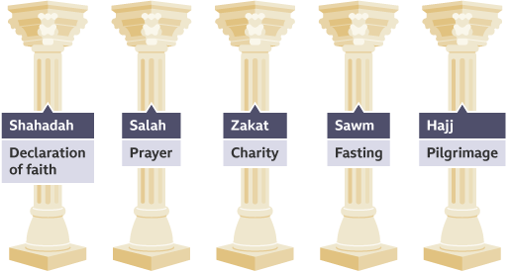
Salah – committing to daily prayers.
Sawm – fasting from just before dawn until sunset.
Zakah – giving a proportion of your wealth to help the poor.
Hajj – pilgrimage to Makkah.
Jihad – the struggle to keep belief in Allah and follow his rules, to follow the Five Pillars of Islam successfully and to defend Islam.
Khums – 20 per cent annual tax. This tax is paid on any profit earned by Shi’a Muslims. The money is split between charities supporting Islamic education and anyone who is descended from Muhammad who is in need.
Amr-bil-Maroof – encouraging people to do what is good: Enjoin what is right and forbid what is wrong (Qur’an 9:71). Maruf is anything that has been approved in Shariah Law.
Nahil Anril Munkar – forbidding evil by discouraging people from doing what is wrong.
Tawalia – showing love. This includes both love for God and love for those who follow him.
Tabarra – disassociation. Shi’a Muslims should not associate with God’s enemies.
SHI’A
Shi’a Muslims combine some prayers, such as the midday and afternoon prayers. Therefore, they may only pray three times a day.
Shi’a Muslims, on the other hand, add further duties. These, along with four of the Five Pillars, are known as the Ten Obligatory Acts.
Shi’a Muslims pray with their hands by their sides.
SUNNI
Sunni Muslims only combine prayers if they have a good reason to, for example if they are travelling.
Sunni Muslims specifically set the duties out clearly and see them as pillars holding up the religion. The pillars keep faith strong, so Sunni Muslims try to keep all five to make them better Muslims and support the religion fully.
Sunni Muslims pray with their hands either folded or by their sides.
Greater jihad is about making the effort to be a good Muslim through a personal struggle to improve spiritually. It is a duty and an act of worship.
Lesser jihad is about defending Islam from threat. Some people still take up arms against anybody they see as an enemy of Islam.
There is no god worthy of worship except God and Muhammad is His messenger.
''Truely, those who believe and do deed of righteousness, and perform As-Salaah and give Zakah, they will have their reward with the Lord.”
“Fight in the way of God those who fight against you, but do not transgress”
“O you who believe! Fasting is prescribed to you as it was prescribed to those before you, that you may [learn] self-restraint”

Slide 2
HOMEWORK:
“Greater Jihad is more important than Lesser Jihad”
Make a plan that will help you answer this FUTURE 12 mark question
(do not write your answer for this)
Research everything you can about Jihad.
Greater and Lesser.
Link it to 10 Obligatory acts AND Peace and Conflict
Use real life examples.

